Slide 1
Regression Testing
Michael McLennan
HUBzero® Platform for Scientific Collaboration
Purdue University
This work licensed under
Creative Commons
See license online:
by-nc-sa/3.0

Slide 2
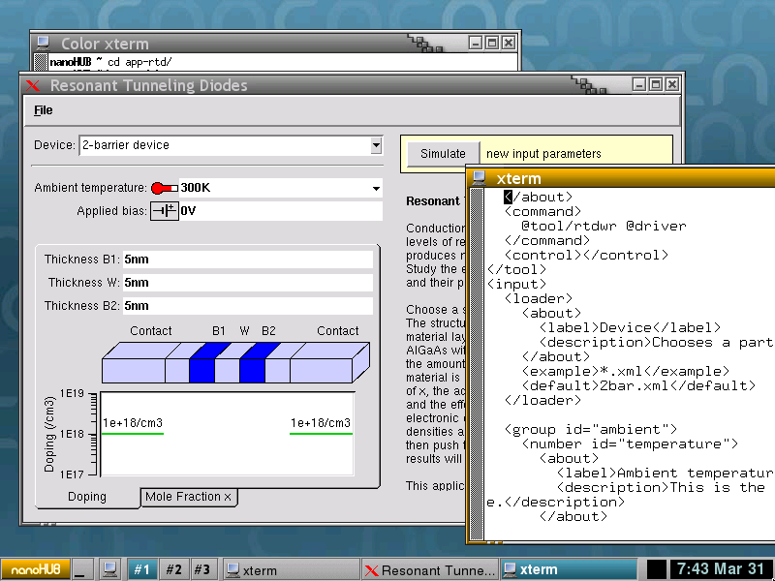
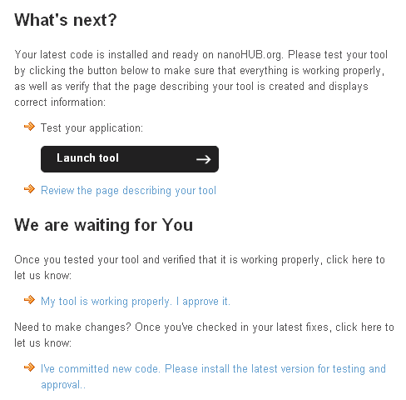
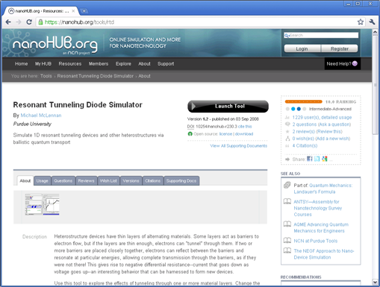
You’ve published it!
Build the tool…
Install, approve…
Published!

Slide 3




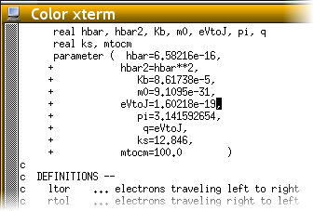
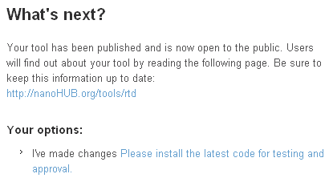
What’s next?
Usually doesn’t end there…
Wishes
Bugs
New physics

Slide 4
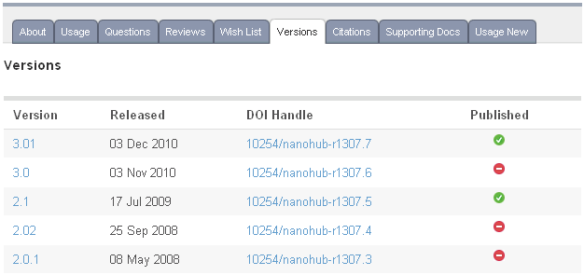
You’ve published it again!
You can publish
multiple versions
and keep more
than one active

Slide 5
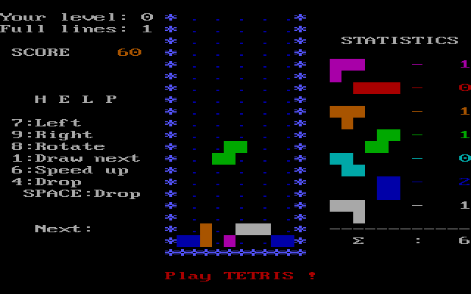
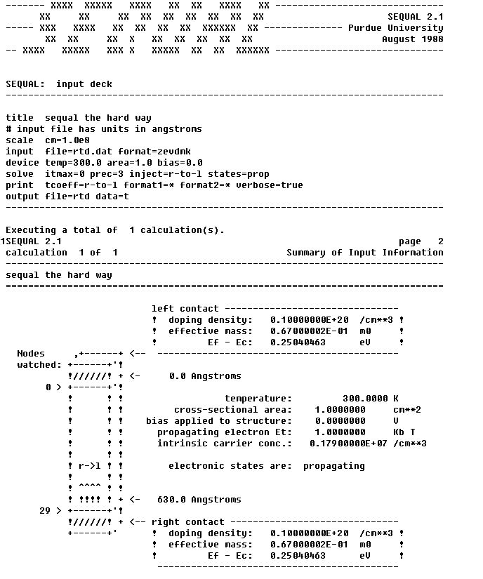


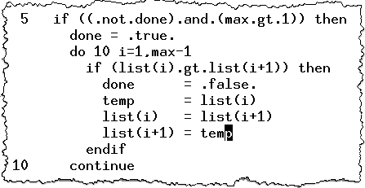
Cautionary Tale
Remember that program from 1985?
Tetris for IBM PC
Screen shot from Wikipedia.org
Copyright Universal Pictures
picture from imdb.com
A few months later,
I went back and added
a sorting routine.
My temp variable
accidentally changed
the ambient temperature!

Slide 6
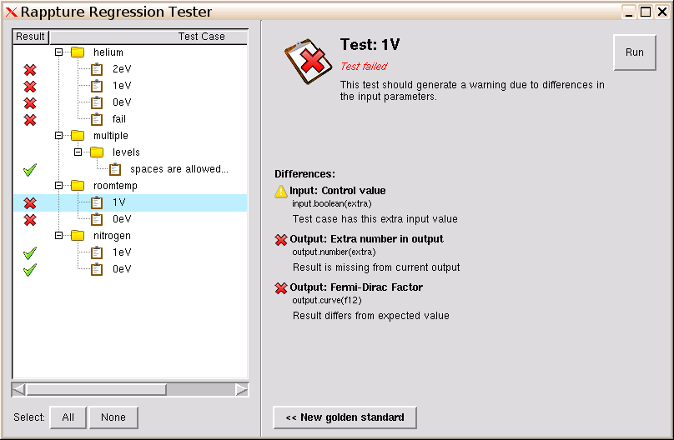
Guard against those errors!
Build up a suite of test cases
Run them as you go along to make sure they still work
Investigate failures and track down the problem

Slide 7
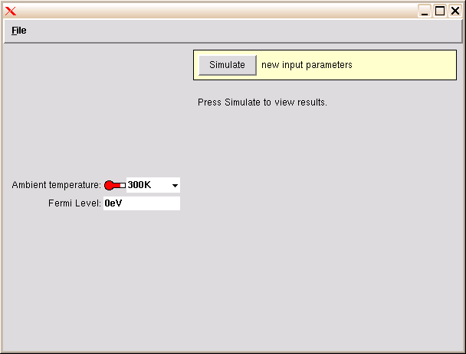
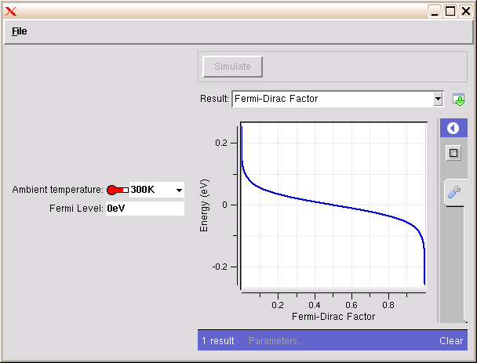

Create test cases
1
Run the desired test case…
Runner
<XML>
driver1827.xml
2
Move run files out of the
“results” directory into
a “tests” directory for
your tool
Your
Program
Results are moved out of
the current working directory
to the “results” directory
<XML>
<XML>
tool.xml
run12703129102.xml
~/data/results/$SESSION

Slide 8
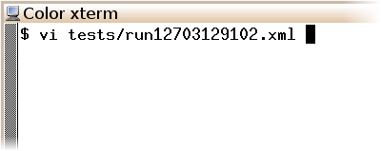
Label test cases
3
Add label/description to each test
<?xml version="1.0"?>
<run>
<test>
<label>roomtemp|0eV</label>
<description>Should work at room temperature and 0eV.</description>
</test>
<tool>
<about>Press Simulate to view results.</about>
<command>tclsh @tool/fermi.tcl @driver</command>
</tool>
<input>
<number id="temperature">
<about>
<label>Ambient temperature</label>
<description>Temperature of the environment.</description>
</about>
separator for test folders

Slide 9
Demo: app-fermi tests

Slide 10

Types of errors
Output results:
Output value has changed
Output value is missing
Output value is extra (not supposed to be there)
Input values:
Input value has changed--label, units, etc.
Input value is missing from test case
Input value is extra (not supposed to be there)
Fix the tool
Fix the test

